Slide 1

Computer Network
Fall 2020
Prof./Dr. Shen Bichuan
College of Computer Science and Engineering
Chongqing University of Technology

Slide 2
The Physical Layer
Chapter 2

Slide 3
Outline of Physical Layer -from end node, router, transmission, network perspectives
It defines the electrical, timing and their interfaces by which bits are sent as signals over the channel.
The lowest layer in the OSI protocol model, foundation on which the network is built
The properties of different kinds of physical channel and transmission techniques will affect and determine the design and performance – throughput, latency, and error rate.
In order for transmission over various channel, modulation is required. In order for efficient channel bandwidth usage, multiplexing is always employed.
But channel bandwidth is always a precious resource and the overall data transmission rate is limited
Three types of transmission media:
Guided (copper wire and fiber optics)
Wireless (terrestrial radio), and
Satellite

Slide 4
Outline of Physical Layer -from end node, router, transmission, network perspectives
Digital Modulation: How analog signals are converted into digital bits and back again.
Multiplexing Schemes: Exploring how multiple conversations can be put on the same transmission medium at the same time without interfering with one another.
The physical layer of end node, router, transmission, network take different functions and roles respectively
Examples of communication systems used in practice for wide area computer networks:
The (fixed) telephone system
The mobile phone system, and
The cable television system.

Slide 5
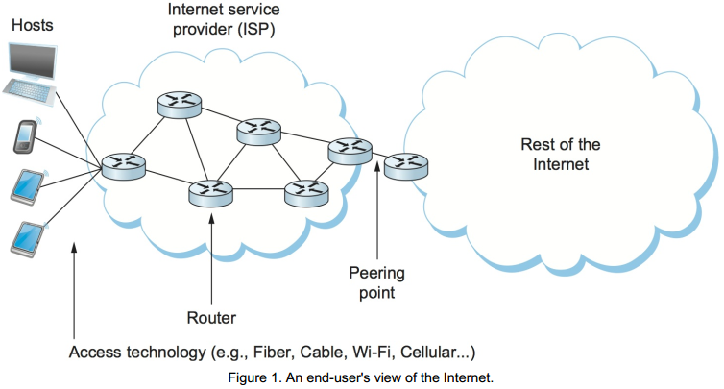
Connecting Nodes and Links

Slide 6
Connecting Nodes and Links
two classes of hardware building blocks:
nodes: convert message and information at app layer to packets and bits at lower layers
links: various types of guided media or wireless, different transmission technologies, access network for last-mile links, long-distance high-speed links for trunk and backbone networks have different requirements, affected by economic and deployment issues

Slide 7
Design Issues
Connectivity and reliability: modulation and encoding, framing, error detection, reliable delivery, and access mediation
Network layer services
Framing
Error control
Flow control

Slide 8
Theoretical Basis for Data Communication
Fourier analysis
Bandwidth-limited signals
Maximum data rate of a channel

Slide 9
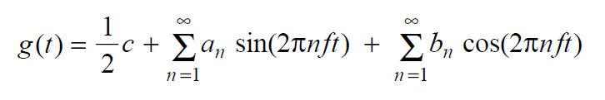
Fourier Analysis
We model the behavior of variation of voltage or current with mathematical functions
Fourier series is used to expand any periodic function with period T
f=1/T – fundamental frequency.
a_{n}, b_{n} – are the sine and cosine amplitudes of the n’th harmonic.
c – is a constant.

Slide 10
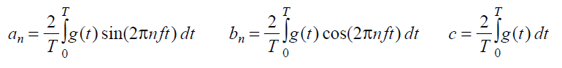
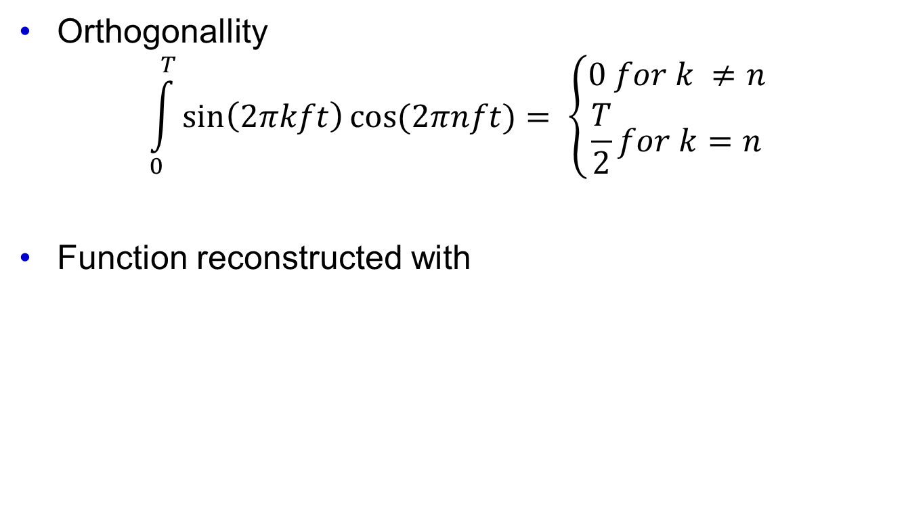
Fourier Analysis
Orthogonallity
$$\int_{0}^{T}{\sin\left(2πkft\right)cos⁡(2πnft)}= \left\{\begin{aligned}0 for k ≠n \\ \frac{T}{2}for k=n\end{aligned}\right.$$
Function reconstructed with

Slide 11
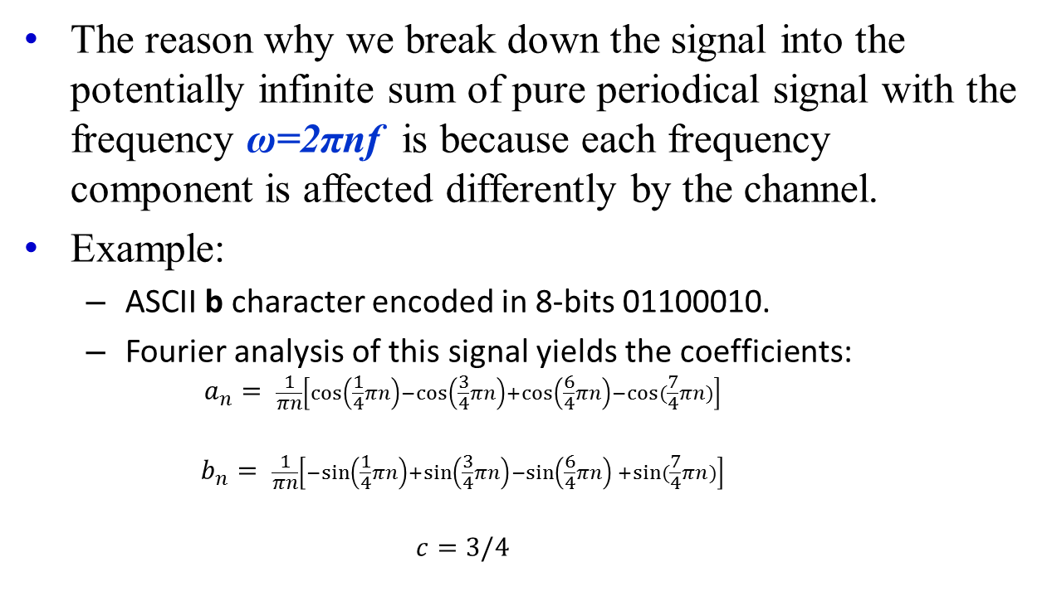
Bandwidth-Limited Signals
The reason why we break down the signal into the potentially infinite sum of pure periodical signal with the frequency ω=2πnf is because each frequency component is affected differently by the channel.
Example:
ASCII b character encoded in 8-bits 01100010.
Fourier analysis of this signal yields the coefficients:
$$a_{n}= \frac{1}{πn}\left[\cos\left(\frac{1}{4}πn\right)−\cos\left(\frac{3}{4}πn\right)+\cos\left(\frac{6}{4}πn\right)−cos⁡(\frac{7}{4}πn)\right]$$
$$b_{n}= \frac{1}{πn}\left[−sin\left(\frac{1}{4}πn\right)+\sin\left(\frac{3}{4}πn\right)−\sin\left(\frac{6}{4}πn\right){+sin⁡(\frac{7}{4}πn)}\right]$$
$$c=3/4$$

Slide 12
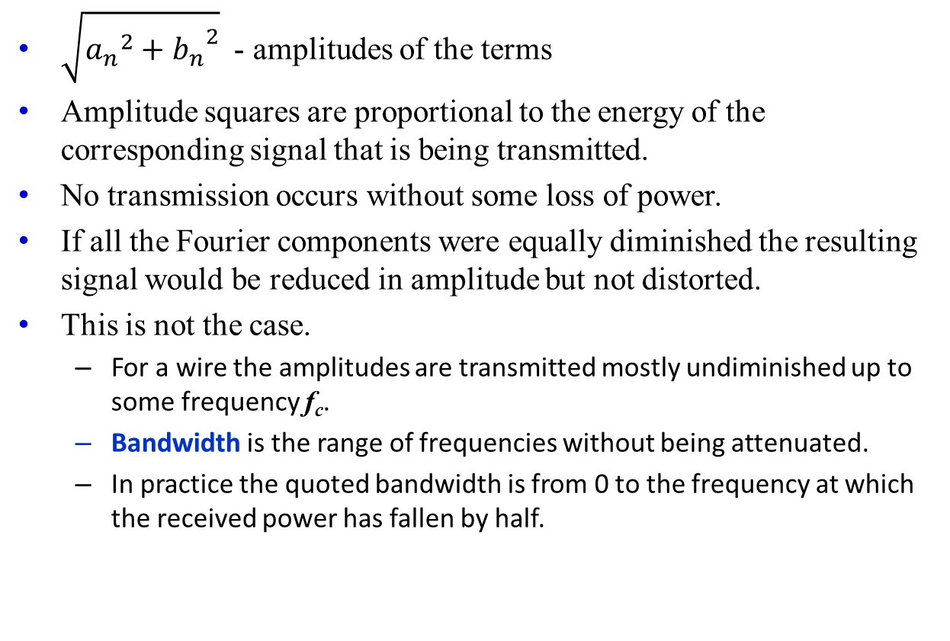
Bandwidth-Limited Signals
$\sqrt{{a_{n}}_{}^{2}+{b_{n}}_{}^{2}}$ - amplitudes of the terms
Amplitude squares are proportional to the energy of the corresponding signal that is being transmitted.
No transmission occurs without some loss of power.
If all the Fourier components were equally diminished the resulting signal would be reduced in amplitude but not distorted.
This is not the case.
For a wire the amplitudes are transmitted mostly undiminished up to some frequency f_{c}.
Bandwidth is the range of frequencies without being attenuated.
In practice the quoted bandwidth is from 0 to the frequency at which the received power has fallen by half.

Slide 13
Bandwidth-Limited Signals
Example:
Filters are commonly used to limit the bandwidth of a signal.
802.11 wireless channels are allowed signals up to (roughly) 20 MHz
Analog TV channels occupy 6 MHz each.
Baseband – signal that run from 0 to a maximum frequency allowed.
Passband – signal that are shifted in frequency to occupy the higher range but of equal bandwidth as a baseband.

Slide 14
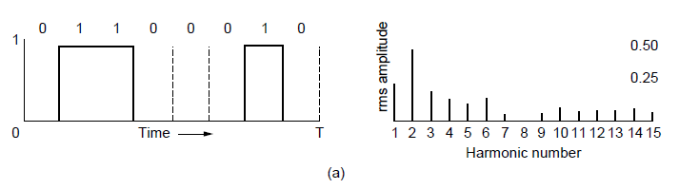
Bandwidth-Limited Signals (1)
A binary signal and its root-mean-square Fourier amplitudes.

Slide 15
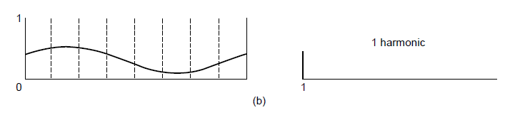
Bandwidth-Limited Signals (2)
(b)-(e) Successive approximations to the original signal.

Slide 16
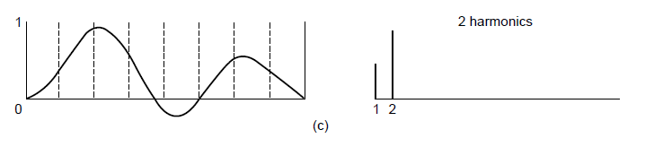
Bandwidth-Limited Signals (3)
(b)-(e) Successive approximations to the original signal.

Slide 17
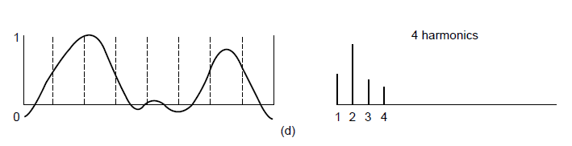
Bandwidth-Limited Signals (4)
(b)-(e) Successive approximations to the original signal.

Slide 18
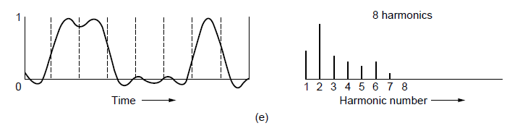
Bandwidth-Limited Signals (5)
(b)-(e) Successive approximations to the original signal.

Slide 19
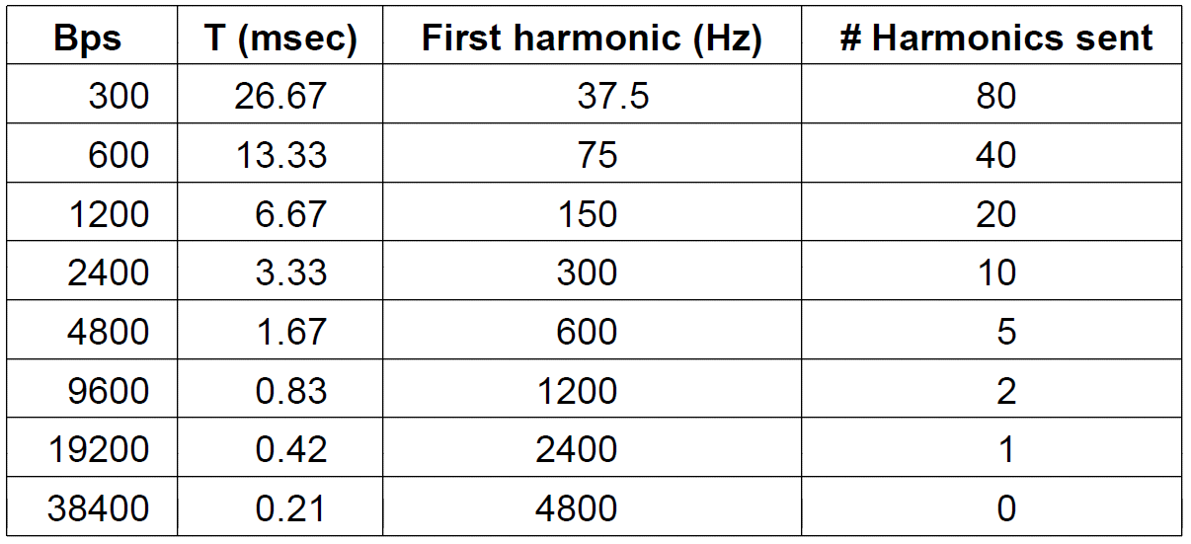
Bandwidth-Limited Signals (6)
Relation between data rate and harmonics for our example.

Slide 20
No Infinite Channel Bandwidth No Ideal Signal
No channel is perfect and the original signal gets modified along the way
Attenuation: signal power absorbed by medium
Distortion: frequency, phase changes
Noise: random background “signals”
response
ideal
actual
freq
B
Different mediums distort different signals differently
Note: that here “bandwidth” means frequency over which signals cannot pass through channel
4

Slide 21
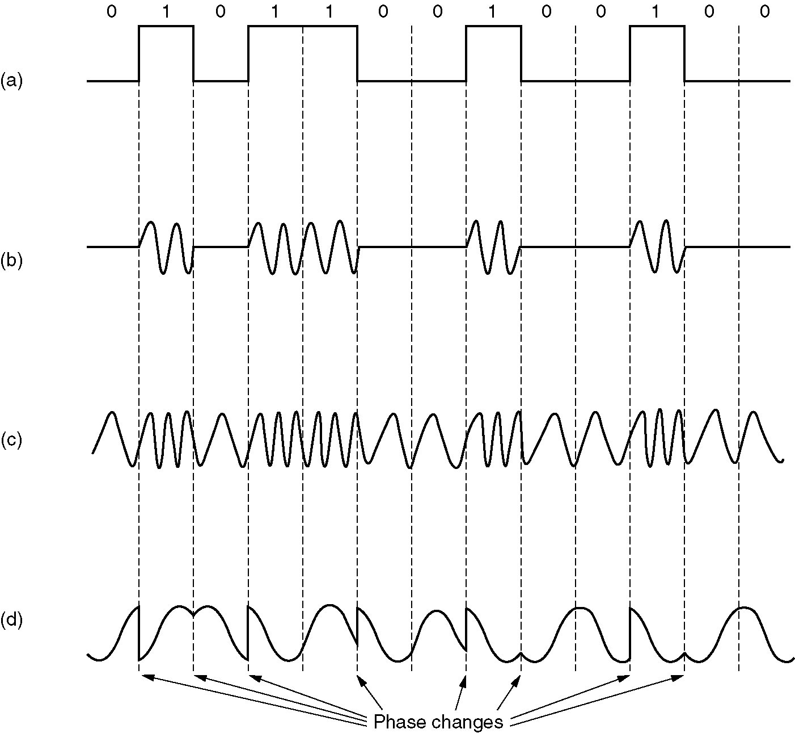
Forms of Digital Modulation
Input Signal
Amplitude Shift Keying
(ASK)
Frequency Shift Keying
(FSK)
Phase Shift Keying
(PSK)

Slide 22
Why Different Modulation Schemes?
Properties of channel and desired application
AM vs FM for analog radio
Efficiency
Some modulations can encode many bits for each symbol (subject to Shannon limit – more on this next class)
Aiding with error detection
Dependency between symbols… can tell if a symbol wasn’t decoded correctly
Transmitter/receiver Complexity

Slide 23
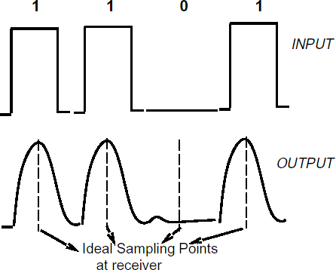
Sampling
To reconstruct signal we need to sample it
7

Slide 24
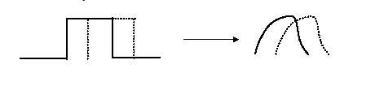
Intersymbol Interference
Bandlimited channels cannot respond faster than some maximum frequency f
Channel takes some time to settle
Attempting to signal too fast will mix symbols
Previous symbol still “settling in”
Mix (add/subtract) adjacent symbols
Leads to intersymbol interference (ISI)
OK, so just how fast can we send symbols?

Slide 25
Bit Rate
Bit Rate: b bits/sec
Time required to send 8 bits one bit at a time is 8/b sec
First harmonic of this signal is b/8 Hz
Example: Telephone line
Bandwidth ~3000 Hz
Number of highest harmonic is ~3000/(b/8) = 24,000/b

Slide 26
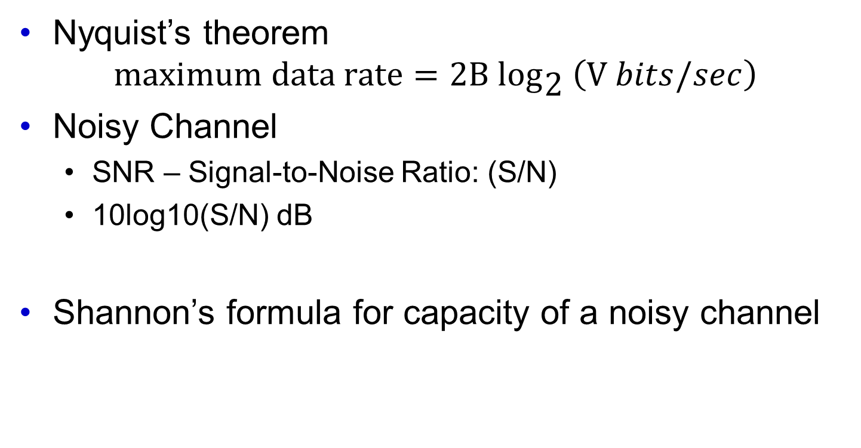
The Maximum Data Rate of a Channel
Nyquist’s theorem
$$\text{maximum} \text{data} \text{rate}=2\text{B} {\text{log}}_{\text{2}} \left(\text{V} bits/sec\right)$$
Noisy Channel
SNR – Signal-to-Noise Ratio: (S/N)
10log10(S/N) dB
Shannon’s formula for capacity of a noisy channel

Slide 27
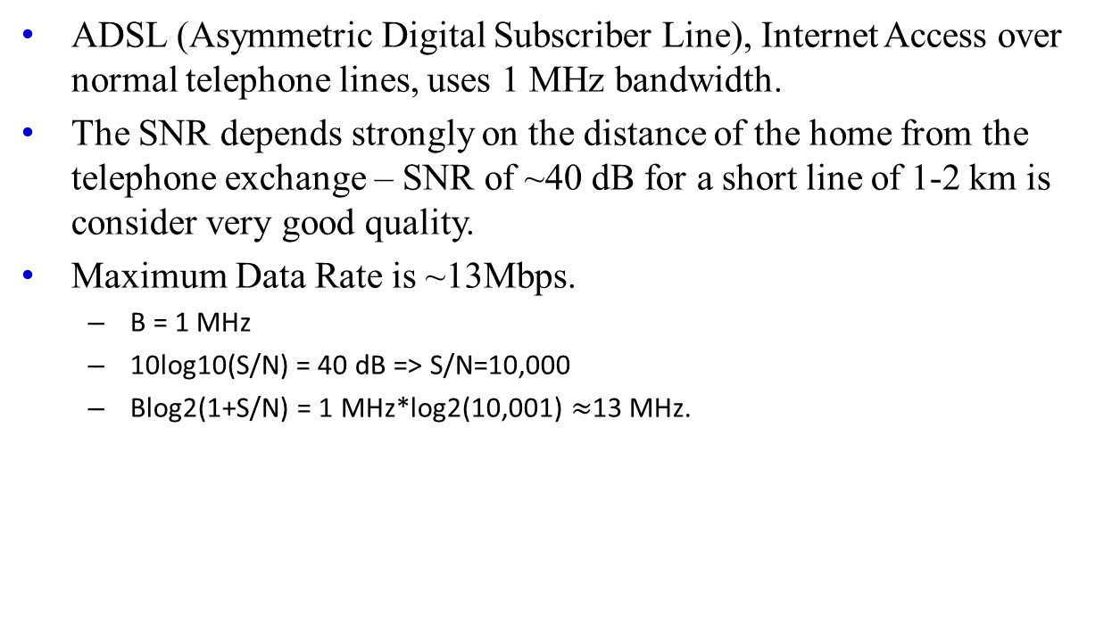
The Maximum Data Rate of a Channel
ADSL (Asymmetric Digital Subscriber Line), Internet Access over normal telephone lines, uses 1 MHz bandwidth.
The SNR depends strongly on the distance of the home from the telephone exchange – SNR of ~40 dB for a short line of 1-2 km is consider very good quality.
Maximum Data Rate is ~13Mbps.
B = 1 MHz
10log10(S/N) = 40 dB => S/N=10,000
Blog2(1+S/N) = 1 MHz*log2(10,001) $≈$13 MHz.

Slide 28
How many kinds of Networks?
Classification of networks from different perspectives
Transmission media: Wired (UTP, coaxial cables, fiber-optic cables) and Wireless including radio, microwave, millimeter wave, laser, infrared, sound, ...
Network size: PAN, LAN and WAN (and MAN)
Management method: Peer-to-peer and Client/Server, distributed, decentralized
Topology (connectivity): Bus, Star, Ring, Tree, Cellular...

Slide 29
Transmission Media
Two main categories:
Guided ― wires, cables
Unguided ― wireless transmission, e.g. radio, microwave, millimeter wave, laser, infrared, sound, sonar etc
Guided media:
Twisted-Pair cables:
Unshielded Twisted-Pair (UTP) cables
Shielded Twisted-Pair (STP) cables
Coaxial cables
Power lines
Fiber-optic cables

Slide 30
Twisted Pairs
Telephony Lines (ADSL) – Twisted pair of wires.
Category 5
100 Mbps Ethernet uses two pairs; one pair for each direction.
1 Gbps Ethernet uses all four pairs in both directions simultaneously.
Defintions:
Full-duplex link
Half-duplex link
Simplex link
Category 6 and 7 soon will be needed to carry rates of 10 Gbps and higher.

Slide 31
Coaxial Cable
It has better shielding and greater bandwidth than unshielded twisted pairs.
50 ohm is used for digital transmission
75 ohm is used for analog transmission and cable television as well as data communication.
Its construction provides high bandwidth and excellent noise immunity.
Bandwidth – few GHz
Widely used for cable televisions and metropolitan area networks.

Slide 32
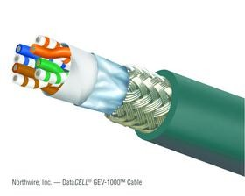
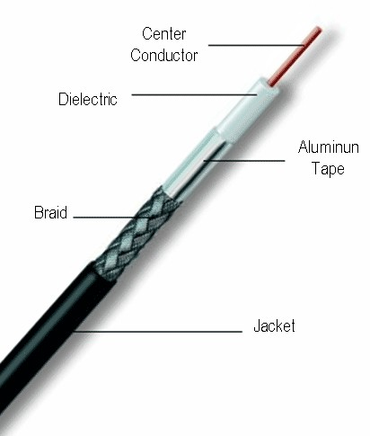

Copper
Typical examples
Category 5/6 Twisted Pair | 10M-10Gbps | 50-100m
Coaxial Cable | 10-100Mbps | 200m
twisted pair
copper core insulation
braided outer conductor outer insulation
coaxial cable (coax)

Slide 33
Power Lines
High-rate communication of interest recently.
Inside home as a LAN
Outside home for broadband Internet access.
Convenient way to perform networking
Problem with wiring since they do attenuate significantly for higher frequencies.
International standards are under development.

Slide 34
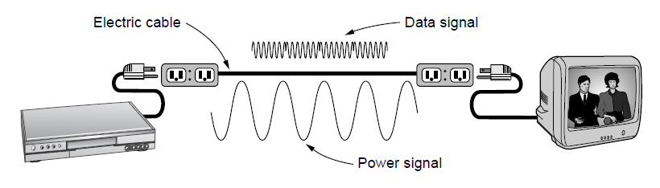
Power Lines
A network that uses household electrical wiring.

Slide 35
Fiber Optics
Moore’s Law – doubling of the number of transistors per chip roughly every 2 years:
Original IBM PC clock speed 4.77 MHz
28 years latter PC’s run four-core CPU’s at 3 GHz.
Increase of a factor of around 2500, 16 per decade.
Wide area communication links went
From 45 Mbps (T3 line in telephone system),
To 100 Gbps. This is hard threshold is due to our inability to convert between electrical and optical signals any faster.
Race between computing power and communication.
An optical transmission system has 3 key componenets:
The light source
The transmission medium, and
The detector.

Slide 36
Fiber Optics
By convention:
A pulse of light indicates a 1 bit, and
the absence of light indicates a 0 bit
Attaching light source to one end of an optical fiber, and
Detector to the other end, we have:
A unidirectional data transmission system
Accepts an electrical signal,
Converts and transmits it by light pulses, and
Reconverts back the output to an electrical signal at the receiving end.
The transmission system would leak light and be useless in practice if it were not for an interesting principle of physics:

Slide 37
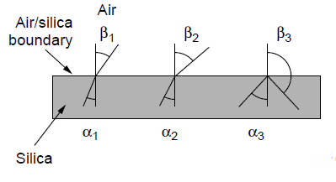
Fiber Optics (1)
Three examples of a light ray from inside a silica fiber impinging on the air/silica boundary at different angles.

Slide 38
Fiber-Optic Cables
Light travels at 3×10⁸ ms⁻¹ in free space and is the fastest possible speed in the Universe
Light slows down in denser media, e.g. glass
Refraction occurs at interface, with light bending away from the normal when it enters a less dense medium
Beyond the critical angle ⇒ total internal reflection

Slide 39
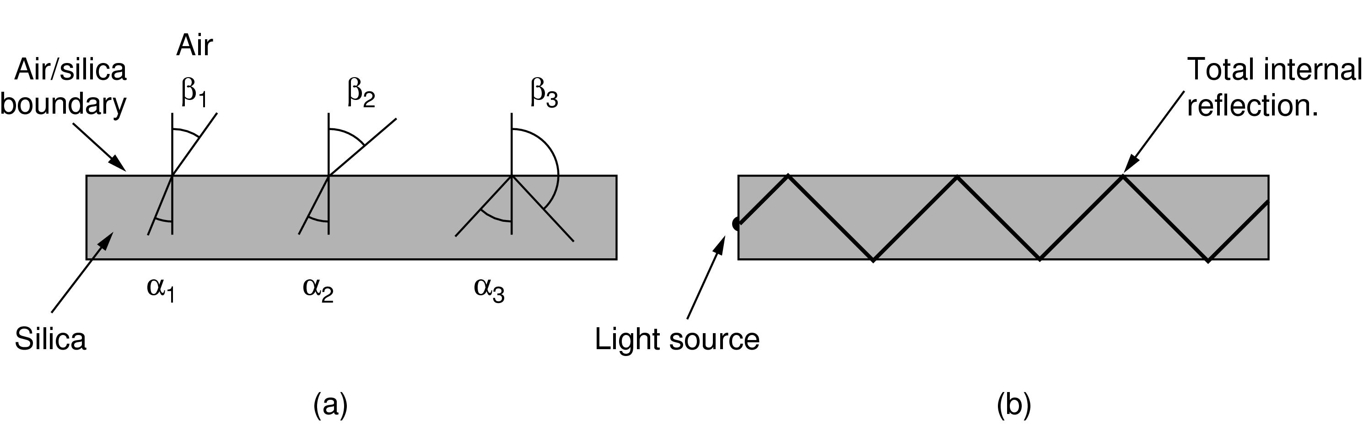
Fiber Optics (2)
Light trapped by total internal reflection.

Slide 40
Fiber Optics
Every light ray that has incidence angle greater then critical angel will be refracted internally: multimode fiber
If fiber’s diameter is reduced to a few wavelength's of light it acts like a wave guide and the light can propagate only in a straight line without bouncing: single-mode fiber.
Transmit data rate of 100 Gbps for 100 km without amplification.

Slide 41
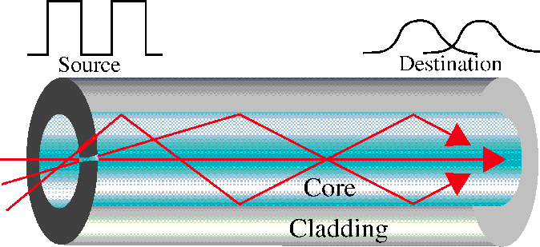
An optical fiber consists of a core (denser material) and a cladding (less dense material)
Simplest one is a multimode step-index optical fiber
Multimode = multiple paths, whereas step-index = refractive index follows a step-function profile (i.e. an abrupt change of refractive index between the core and the cladding)
Light bounces back and forth along the core
Common light sources: LEDs and lasers

Slide 42
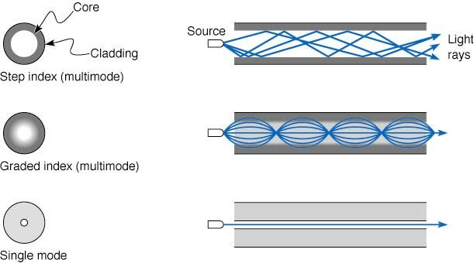
Fiber Optics
Typical examples
Multimode Fiber
Single Mode Fiber
100Mbps-10Gb 1-100Gbps
500-2000m
100m-40km
Cheaper to drive (LED vs laser) & terminate
Longer distance (low attenuation) Higher data rates (low dispersion)

Slide 43
Transmission of Light Through Fiber
Attenuation of light through glass depends on the wavelength of the light (as well as on some physical properties of the glass).
It is defined as the ratio of input to output signal power.
Figure on the next slide shows the attenuation in units of decibels per linear kilometer of fiber.

Slide 44
Fiber Optics
1.3 micron band
Bandwidth of 0.17 microns
λ₁ = 1.25 microns => f₁ = 3x10⁸/1.25x10⁻⁶
λ₂ = 1.35 microns => f₂ = 3x10⁸/1.35x10⁻⁶
Bandwidth: f₂ - f₁= 30,000 x 10⁹ = 30,000 GHz
Signal-to-noise Ratio 10 dB
=> 300 Tbps.

Slide 45
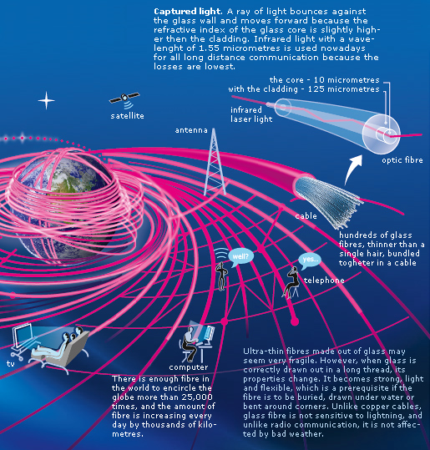
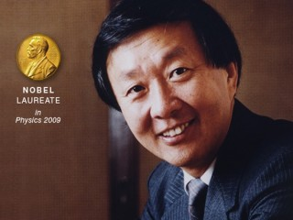
Charles K. Kao — Father of Fiber Optics Nobel Laureate 2009, Former CUHK President

Slide 46
Advantages and Disadvantages
Noise resistance ― external light is blocked by outer jacket
Less signal attenuation ― a signal can run for miles without regeneration (currently, the lowest measured loss is about ~4% or 0.16dB per km)
Higher bandwidth ― currently, limits on data rates come from the signal generation/reception technology, not the fiber itself
Cost ― Optical fibers are expensive
Installation/maintenance ― any crack in the core will degrade the signal, and all connections must be perfectly aligned

Slide 47
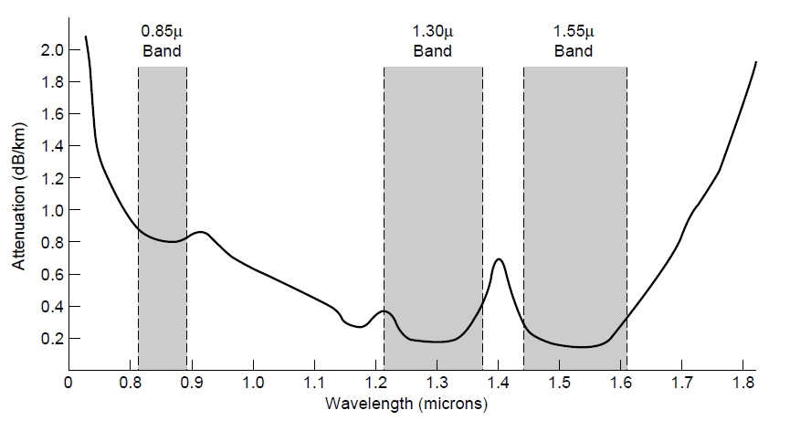
Transmission of Light Through Fiber
Attenuation of light through fiber in the infrared region

Slide 48
Transmission of Light Through Fiber
Three wavelengths bands are most commonly used at present for optical communication:
0.85μ
1.30μ and
1.55μ
They have bands ranging from 25,000 to 30,000 GHz wide.
Chromatic dispersion – the spreading of wave as it propagates down on a fiber.
Solitons – making the pulses in a special shape related to the reciprocal of the hyperbolic cosine causes nearly all the dispersion effects to cancel out. This was achieved in Lab env.

Slide 49
Fiber Cables
Similar to Coaxial except they are without the braid. (See figure in the next slide).
In Multimode fibers, core is typically 50 microns (~ thickness of human hair).
In Single-mode fibers the core is 8-10 microns.

Slide 50
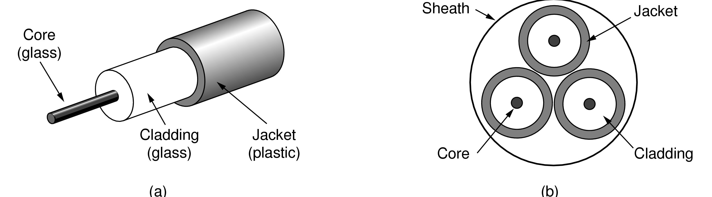
Fiber Cables (1)
Views of a fiber cable

Slide 51
Fiber Cables
Core is enclosed in by glass cladding with a lower index of refraction than the core to keep all the light in the core.
Thin plastic jacked to protect the cladding.
Fibers are typically grouped in bundles protected by an outer sheath.
Fiber Cables are:
Laid on the ground within a meter of the surface,
Transoceanic fiber cables are buried in trenches as the are laid on the see floor.
Fibers are connected in three different ways:
They can terminated in connectors and be plugged into fiber sockets; connectors lose about 10%-20% of the light but they make it easy to reconfigure systems
Spliced mechanically obtained by carefully cutting ends next to each other and placed within a special sleeve and clamp them in place. Alignment can be improved by passing light through the junction and then making adjustments as necessary.
Two pieces of fiber can be fused (melted) together to form a solid connection. Fused cable can be almost as good as a single drawn fiber. But even here there some amount of loss.

Slide 52
Fiber Cables
Two types of technologies are used to drive the signals:
LED (Light Emitting Diodes), and
Semiconductor Lasers.
They can be tuned in wavelengths by inserting:
Febry-Perot interferometers, or
Mach-Zehnder interferometers
Febry-Perot interferometers are simple resonant cavities consisting of two parallel mirrors. The length of the cavity selects out those wavelengths that fit inside an integral number of times.
Mach-Zehnder interferometers separate the light into two beams. The beams travel slightly different distances. Then they are recombined at the end and are in phase for only certain wavelengths.

Slide 53
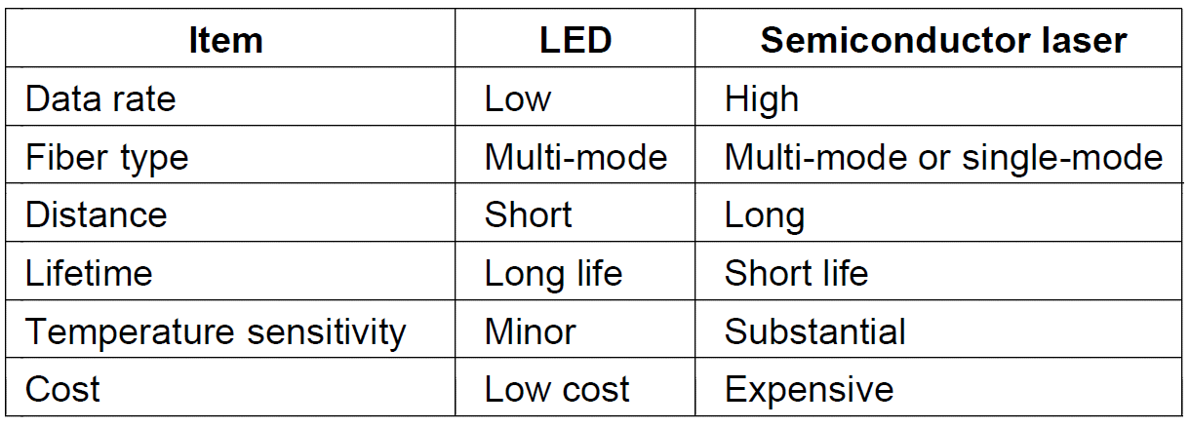
Fiber Cables (2)
A comparison of semiconductor diodes and LEDs as light sources

Slide 54
Fiber Cables
Receiving end of an optical fiber consists of a photodiode, which gives off an electrical pulse when struck by light.
The response time of photodiodes that convert the signal from the optical to the electrical domain limits data rates to about 100 Gbps.
Terminal noise is also an issue hence the light should be injected with sufficient energy in order to be detected.
By making the pulses powerful enough the error rate can be made arbitrarily small.

Slide 55
Fiber Optics vs. Copper Wire
Fiber has numerous advantages:
Higher bandwidths,
Low attenuation (50 km vs. 5 km repeaters)
Not affected by power surges, electromagnetic interference, or power failures.
Not affected by corrosive chemicals in the air.
It is thin and lightweight.
Cable ducts are full – hence removing copper wires and replacing them with Fiber is good alternative.

Slide 56
Fiber Optics vs. Copper Wire
Disadvantages of Fiber Optics:
Requires highly skilled workers,
They can be damaged easily,
Two way transmission requires either two different fibers or two different bands of the same fiber.
Future of all fixed data communication over more than short distances is clearly with fiber.

Slide 57
Wireless Transmission
The Electromagnetic Spectrum
Radio Transmission
Microwave Transmission
Infrared Transmission
Light Transmission
Attenuation and loss over air channels, refraction and multipath fading, interferences cross channels or nearby, air interfaces and protocols, antenna design and optimization, power management and optimization

Slide 58
Electromagnetic Spectrum
Electromagnetic waves were predicted by James Clerk Maxwell in 1865.
Those waves were observed by Heinrich Hertz in 1887.
Number of oscillations per second are called frequency and a measured by Hz.
The distance between two consecutive maxima (or minima) is called a wavelength.

Slide 59
Physics of Electromagnetic Wave
A wave is the propagation of a vibration through the medium.
Alternating compression and rarefaction phases create a traveling wave.

Slide 60
Electromagnetic Wave
Wavelength,
λ: distance between two consecutive peak compressions (or rarefactions) in space (not in time).
Wavelength, λ,is also the distance the wave travels in one cycle of the vibration of air particles.
Frequency,
f: is the number of cycles of compression (or rarefaction) of air particle vibration per second.
Wave travels a distance of f wavelengths in one second.

Slide 61
Electromagnetic Wave
Velocity of the wave in vacuum is constant and is about equal to speed of light, c, independent of the wavelength:
c = 3x10⁸ m/sec
c = fλ.
In other mediums (e.g., air) the speed of wave is about 2/3 of the total speed of light and slightly frequency dependent.

Slide 62
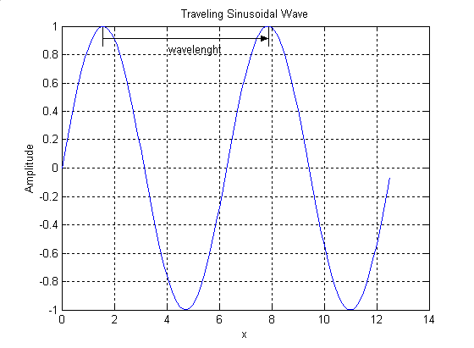
Traveling Wave
λ

Slide 63
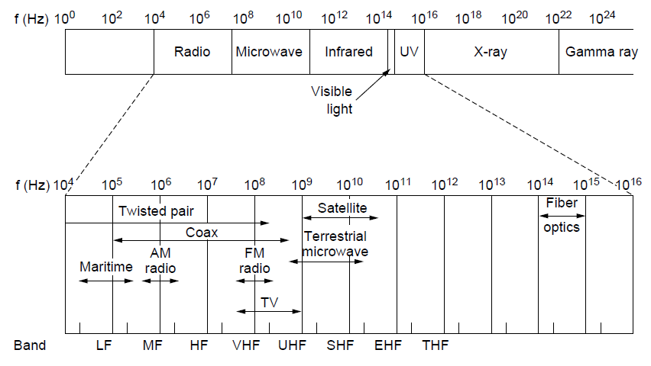
The Electromagnetic Spectrum (1)
The electromagnetic spectrum and its uses for communication

Slide 64
Wireless Transmission
Attenuation and loss over air channels
refraction and multipath fading
interferences cross channels or nearby
air interfaces and protocols
antenna design and optimization
power management and optimization

Slide 65
Wireless Transmission
Most transmission use relatively narrow frequency band (Δf/f_{c} << 1):
High transmission power
Low power consumption
Low signal attenuation and distortion, jitter or chromatic dispersion called in optical fiber
Reasonable data rates
Suitable for dense multiplexing of channels
Subject to multipath fading
Three variations of spread spectrum communication that uses much higher bandwidth:

Slide 66
Wireless Transmission
Frequency hopping spread spectrum
100’s frequency hop's per second
Popular military communications
Makes transmissions hard to detect
Next to Impossible to jam
Offers good resistance to multipath fading
High resistance to narrowband fading
Used commercially: Bluetooth

Slide 67
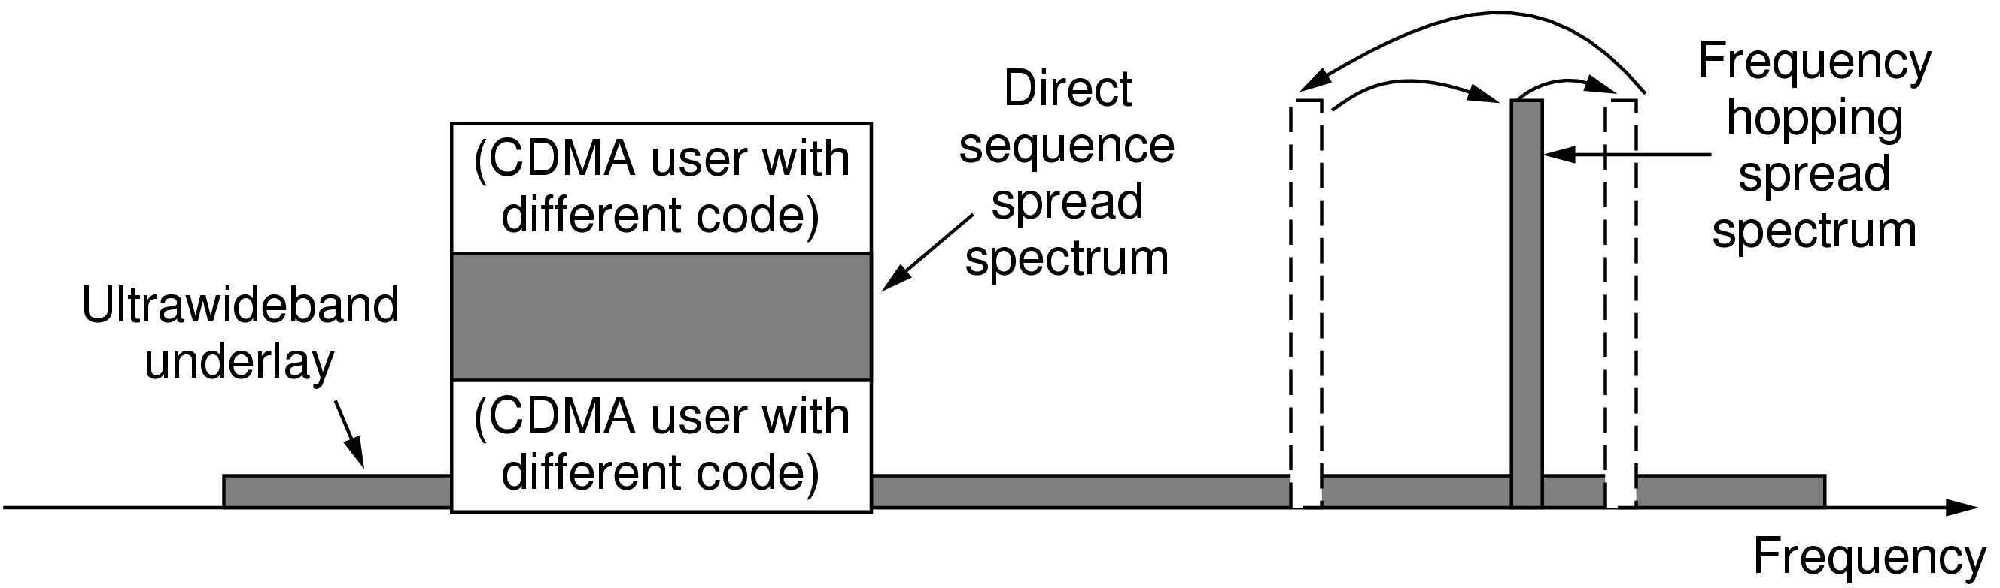
The Electromagnetic Spectrum (2)
Spread spectrum and ultra-wideband (UWB) communication

Slide 68
Wireless Transmission
Direct sequence spread spectrum
Uses a code sequence to spread the data signal over a wider frequency band.
CDMA (Code Division Multiple Access)
High resistance to narrowband fading

Slide 69
Wireless Transmission
Ultra-WideBand (UWB)
Sends a series of rapid pulses, varying their positions to communicate information.
The rapid transitions lead to a signal that is spread thinly over a vary wide frequency band.
Bandwidth of the signal of UWB is at least 500MHz or at least 20% of the center frequency band.
It is transmitted at a low-power but with very high bandwidth.
The other high-energy low bandwidth signals do not interfere with it.

Slide 70
Radio Transmission
RF waves are:
Easy to generate
Can travel a long distance,
Penetrate buildings easily,
Hence they are used for communication.

Slide 71
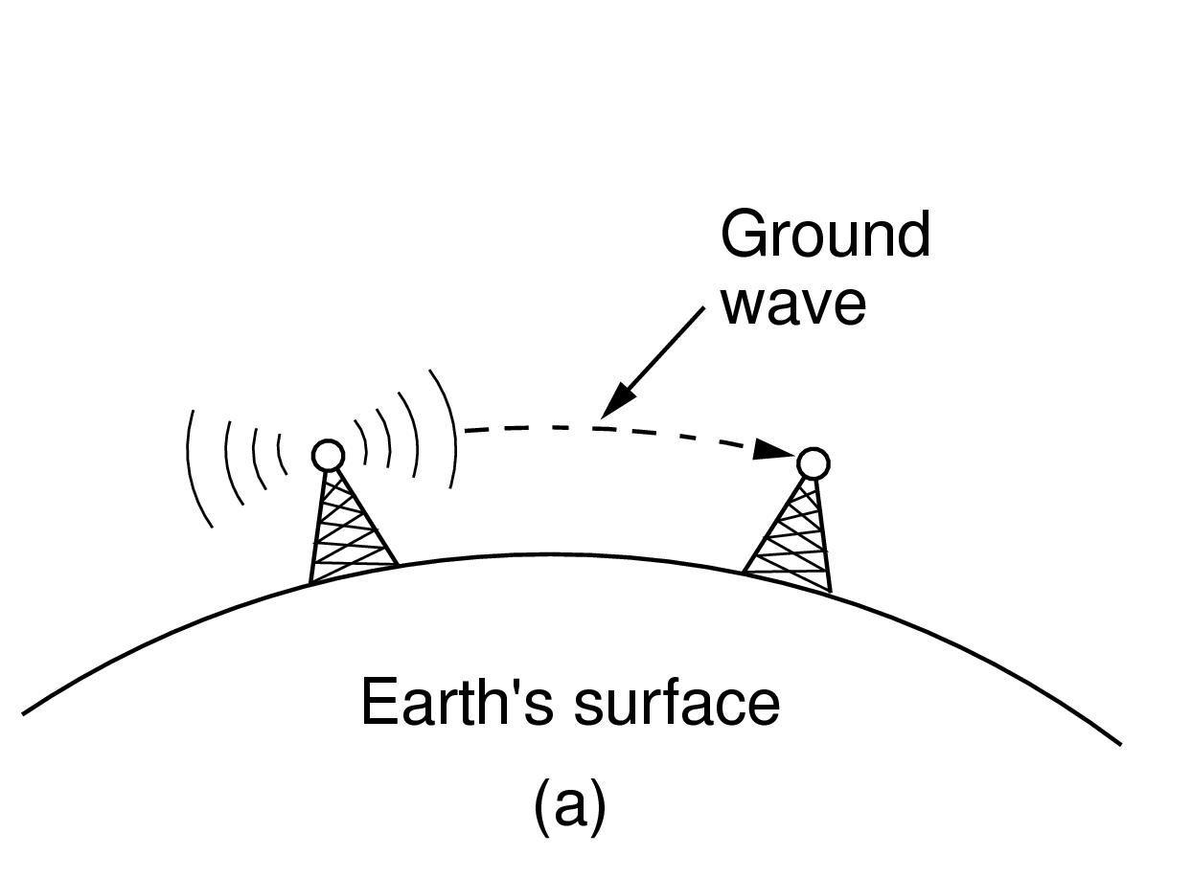
Radio Transmission (1)
In the VLF, LF, and MF bands, radio waves follow the curvature of the earth

Slide 72
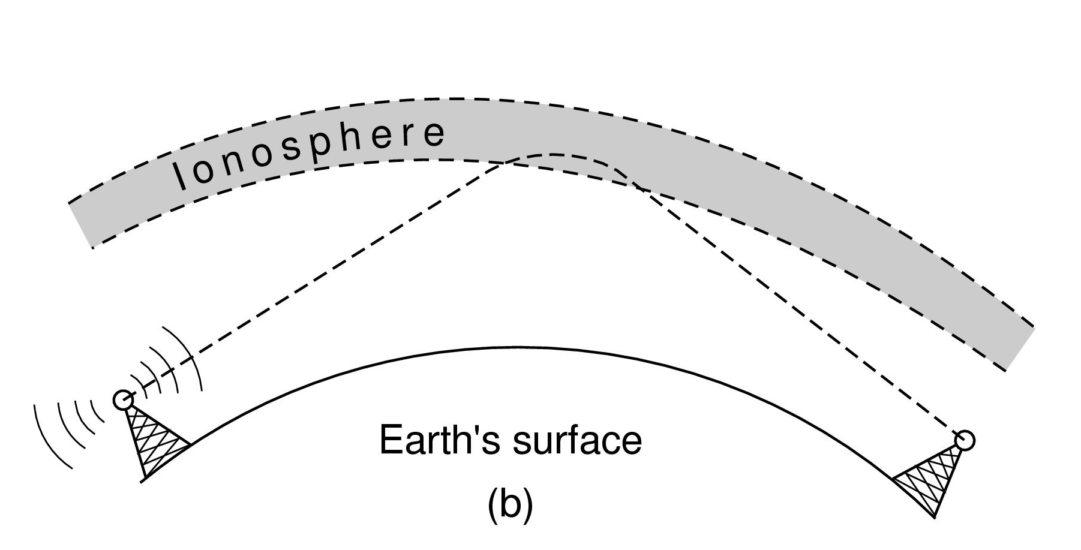
Radio Transmission (2)
In the HF and VHF band, they bounce off the ionosphere.

Slide 73
Microwave Transmission
Above 100 MHz the waves travel in nearly straight line and hence they can be narrowly focused.
Higher S/N ratio is obtained by parabolic antenna.
Transmission and Reception antennas must be carefully aligned.
Multiple transmissions possible without interference.
MCI and AT&T built its entire system with microwave communications passing between towers tens of kilometers apart.

Slide 74
Microwave Transmission
Multipath fading is often a serious problem for Microwaves.
Multipath fading – delayed waves may arrive out of phase with the direct wave and can cause cancelation.
It is a widely used technology.
Cost very little to set up a communication channels.
It is relatively inexpensive putting up towers (50 km apart) relative to putting a 50 km fiber-optic wire.

Slide 75
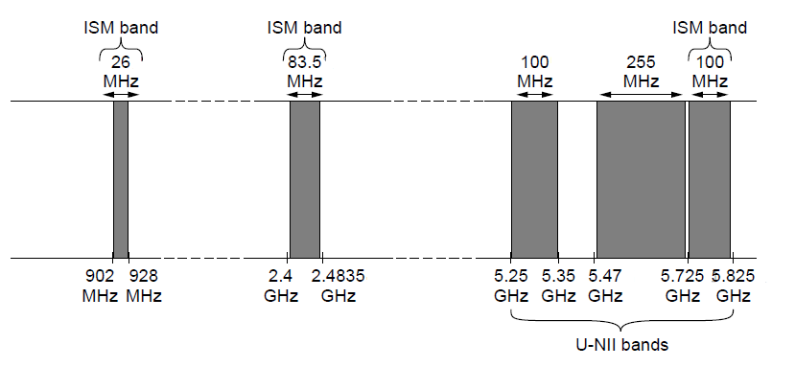
Electromagnetic Spectrum
ISM and U-NII bands used in the United States by wireless devices

Slide 76
Communication Satellites
Geostationary Satellites
Medium-Earth Orbit Satellites
Low-Earth Orbit Satellites
Satellites Versus Fiber

Slide 77
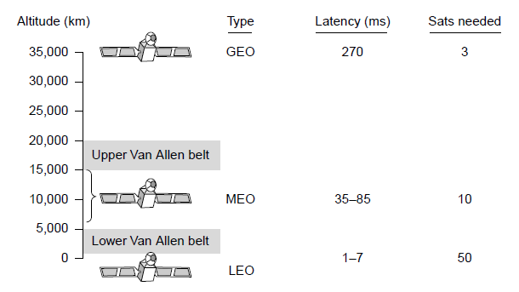
Communication Satellites
Communication satellites, some properties, including: altitude above earth, round-trip delay time, number of satellites for global coverage.

Slide 78
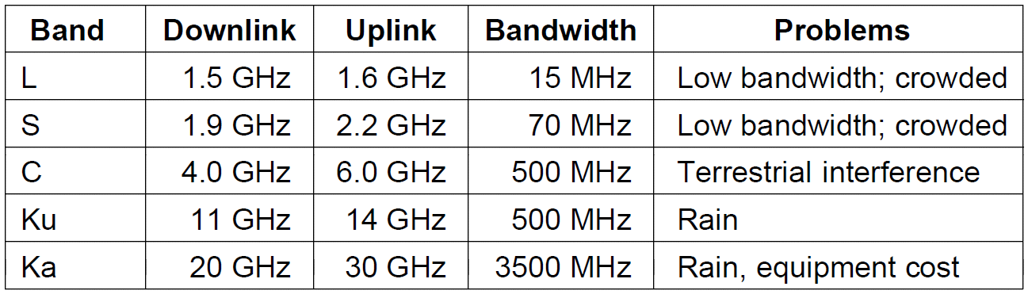
Geostationary Satellites (1)
The principal satellite bands

Slide 79
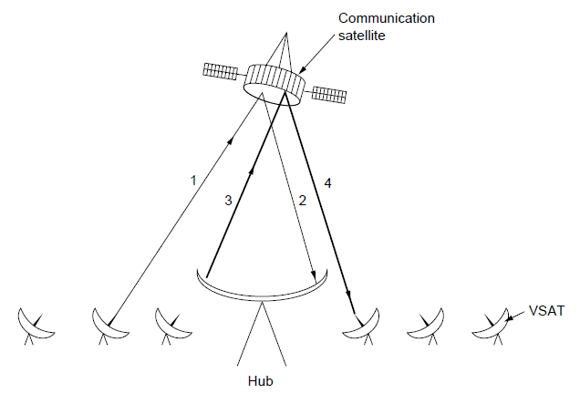
Geostationary Satellites (2)
VSATs using a hub.

Slide 80
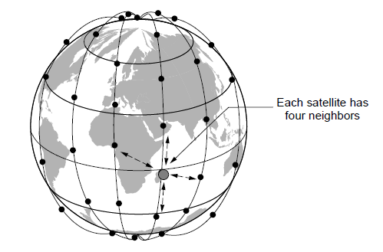
Low-Earth Orbit Satellites (1)
The Iridium satellites form six necklaces around the earth.

Slide 81
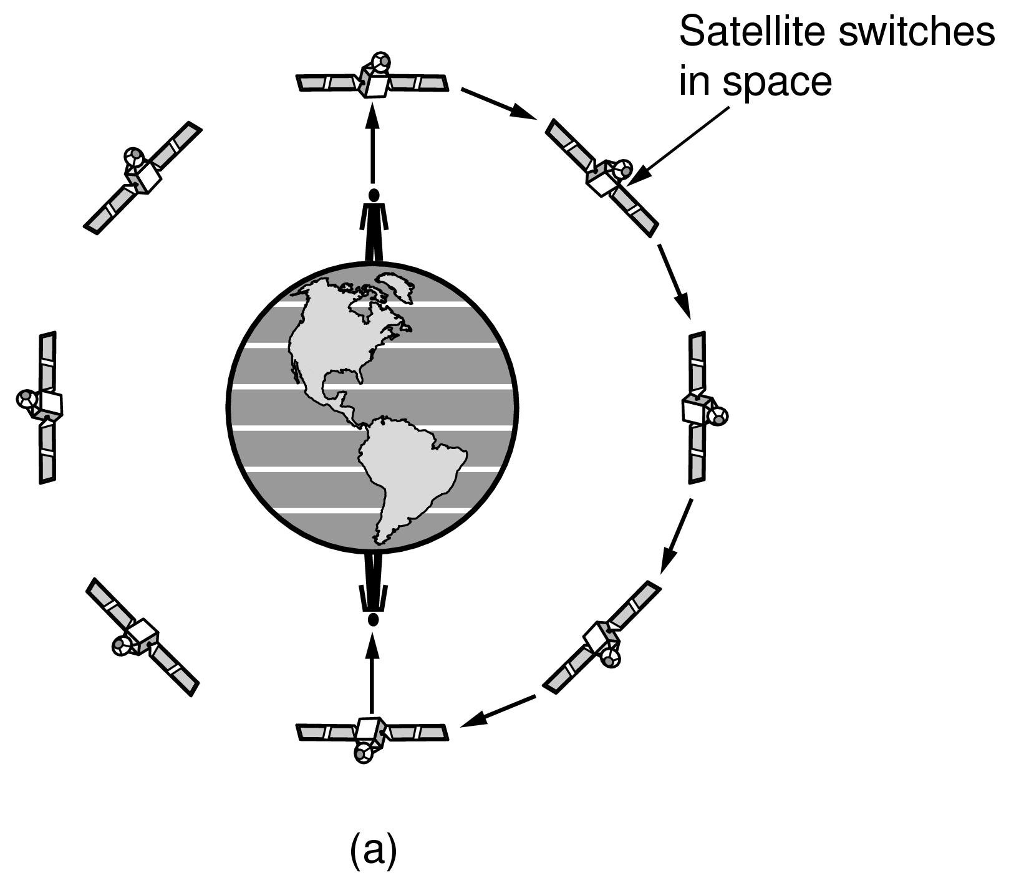
Low-Earth Orbit Satellites (2)
Relaying in space.

Slide 82
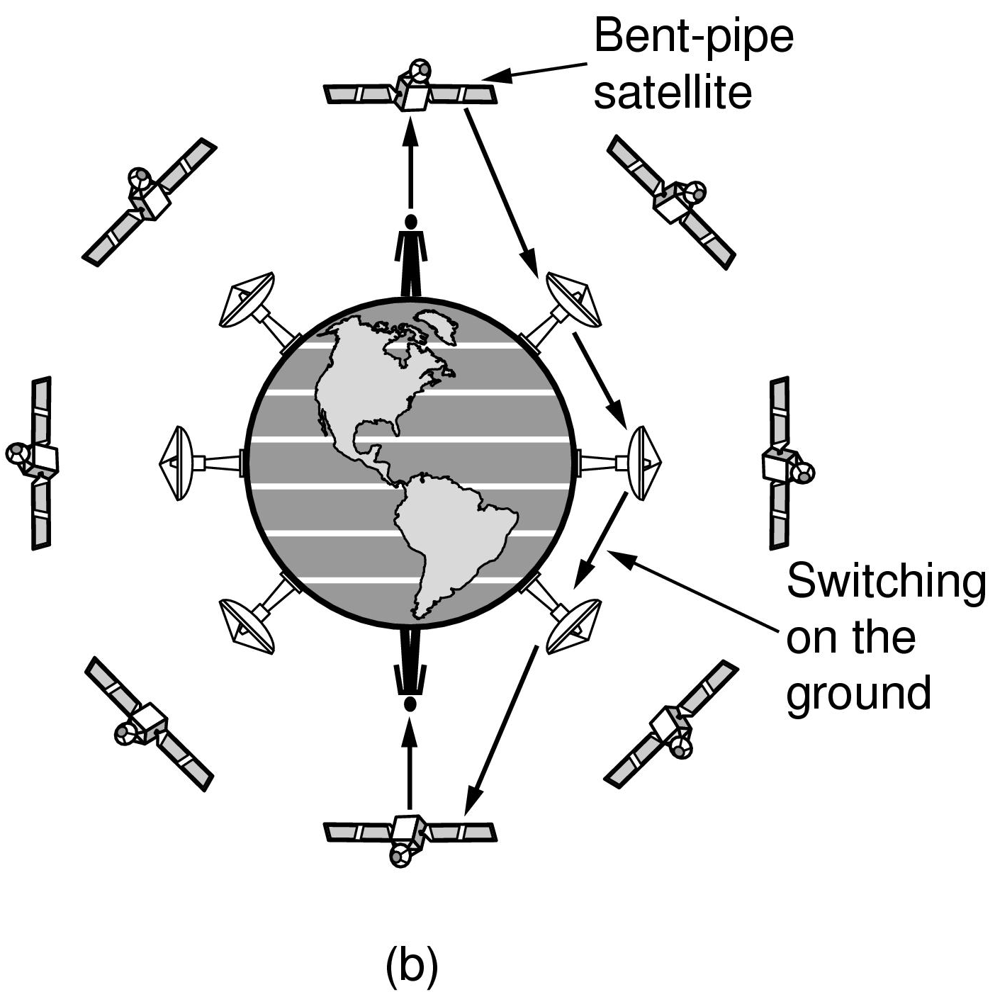
Low-Earth Orbit Satellites (3)
Relaying on the ground

Slide 83
Network Topology
Classification of network topology by topology structure has important influence on the design and implementation, function, management, reliability and cost of the whole network.
What kind of network topology should be selected depends on factors including actual needs, technologies, costs, management and maintanence.
The topological structure of computer network system mainly includes bus, star, ring, tree and grid.

Slide 84
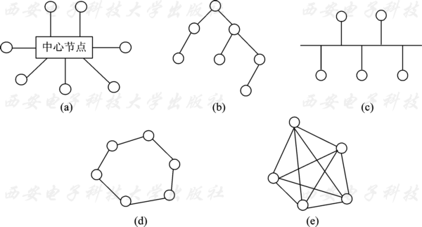
Network Topology
Figure. Schematic diagram of network topology
(a) star structure; (b) tree structure; (c) bus structure; (d) ring structure; (e) network structure

Slide 85
Network Topology
LANs and small area networks have simple structures, interconnecting and wide area networks are complex.
Different topologies and structures impact traffic distribution, routing and networking protocols.
Provide redundancy, multipath routing and fault tolerant capabilities.
Represented and modeled by graph with nodes and vertex, links and edges, directed or not-directed, weighted or not-weighted.

Slide 86
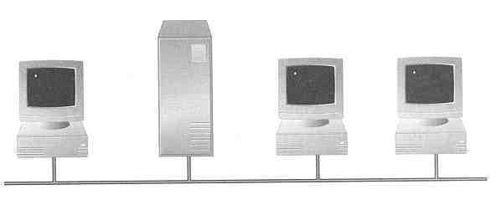
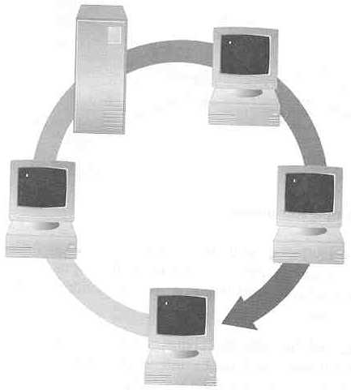
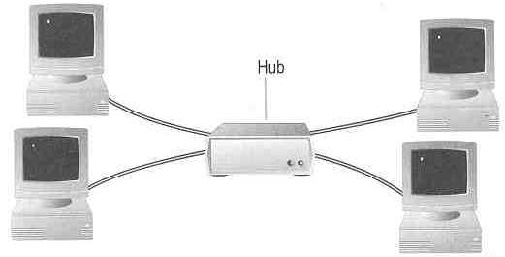
Topology ― 3 basic types
How so many computers are connected together?
Bus Topology Ring Topology
Star Topology
Hub

Slide 87
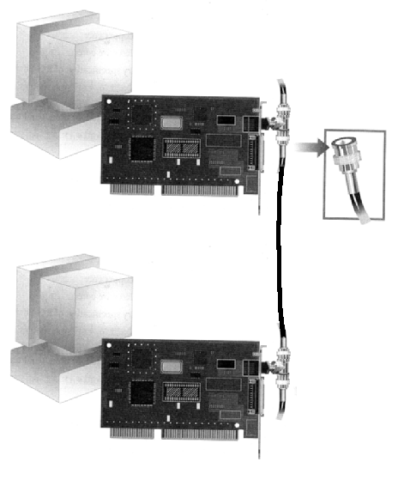
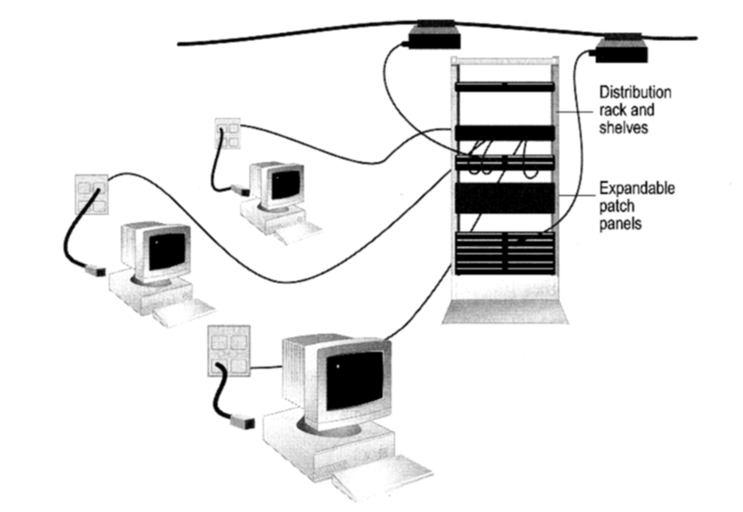
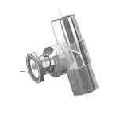
How to construct a network with Bus / Star Topology?
Bus Topology
Coaxial cable
Star Topology
BNC T-Connector
Network Card

Slide 88
Ring Topology
Every computer serves as
a repeater to boost signals
Typical way to send data:
Token passing
only the computer who
gets the token can send
data
Disadvantages
Difficult to add computers
More expensive
If one computer fails, whole network fails
Ack
T
T
T
T
T
data
data
data
data
T
data
T
T
T
Ack
T
T
data
Ack
T
T
Ack

Slide 89
Digital Modulation and Multiplexing
Baseband Transmission
Passband Transmission
Frequency Division Multiplexing
Time Division Multiplexing
Code Division Multiplexing

Slide 90
Transmission Encoding
Encoding is for expediating the channel transmission effectiveness and efficiency
Variant channel encoding formats employed and adopted, such as NRZ, NRZI, Manchester, and 4B/5B etc.
The purpose is to assist recovering clock signals from the bit streams and synchronization between the sender and receiver

Slide 91
Transmission Encoding
The purpose is to assist recovering clock signals from the bit streams and synchronization between the sender and receiver
Secondly, narrow and limit signal bandwidths for transmission, this helps signal recovery at the receiver side and helps channel multiplexing and transmission line usage efficiency.

Slide 92
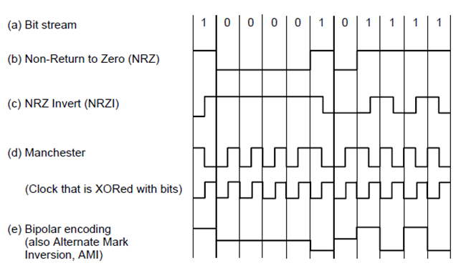
Baseband Transmission
Line codes: (a) Bits, (b) NRZ, (c) NRZI, (d) Manchester, (e) Bipolar or AMI.

Slide 93
Bandwidth Efficiency
Bandwidth is often a limited resource.
Higher-frequency signals are increasingly attenuated
Higher-frequency signals require faster electronics.
Using limited bandwidth more efficiently:
Using more than 2 signal levels.
With four (4) signal levels we could transmit 2 bits with a single symbol.
Symbol rate vs. Bit rate.

Slide 94
Clock Recovery
Solving the problem of large number of repeated bits (e.g., 15 zeros) requires accurate clocking with is expensive solution for commodity equipment.
Strategies:
Sending separate clock signal to the receiver.
Good solution for a computer buses or short cables in which there several parallel lines.
Wasteful solution for most networks links.

Slide 95
Clock Recovery
Incorporating clock into the signal itself:
Manchester encoding is used in classic Ethernet.
XOR-ing the clock signal with zero it low to high transition (just like the clock).
XOR-ing with 1 it makes it is inverted and makes a high-to-low transition.
Downside – 2 times the bandwidth of the original signal.

Slide 96
Clock Recovery
A different strategy is based on the idea that we should code the data to ensure that there are enough transitions in the signal.
NRZ coding will have problems only for long runs of 0’s and 1’s (not for short ones).
First step would be to code a 1 as a transition and 0 as a no transition (NRZI – Non-Return-to-Zero Inverted)
USB (Universal Serial Bus) standard uses NRZI.
Long run of zeros have the same problem as the original.

Slide 97
Clock Recovery
4B/5B – every 4 bits is mapped into a 5-bit pattern with a fixed translation table.
This table is crafted with no more than three consecutive 0s.
Adds 25% overhead (better than 100% as in Manchester Encoding).

Slide 98
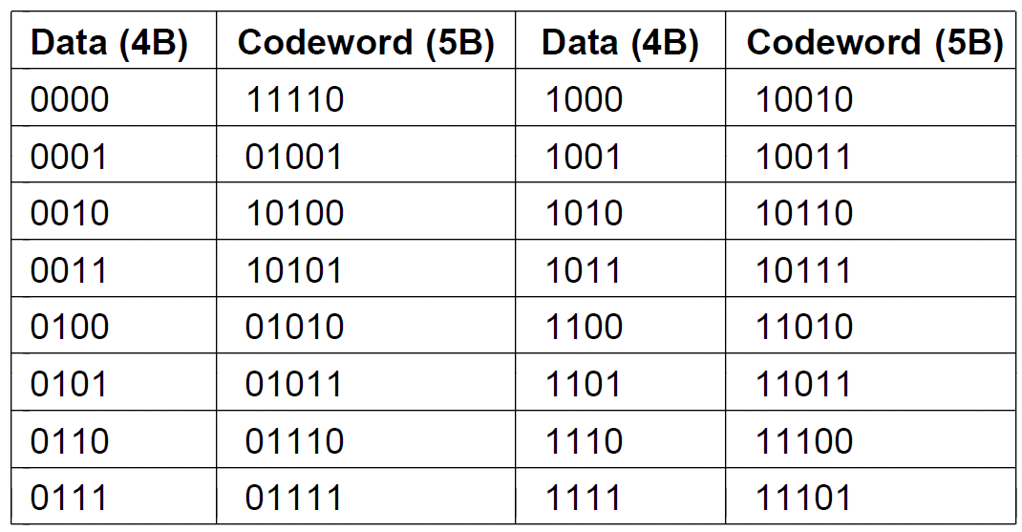
Clock Recovery
4B/5B mapping.

Slide 99



Slide 100
Clock Recovery
There are plenty of free combinations in 4B/5B mapping to use it for control signals:
1111 – represents an idle line
1100 – represents start of the frame.
“Random” Data:
Scrambling of the data. need descrambling at the receiving side
XOR data with a pseudo random sequence.
Additional advantages:
No extra bandwidth is need.
It is better than original signal (white noise spectrum of random process)
Energy is equally spread across all bandwidth uniformly.

Slide 101
Baseband to Passband Signals
Shift the Baseband to Passband without using extra energy of the signal.
Transmit the Passband signal.
In receiver translate back to original Baseband.
Shifting of a Baseband to a Passband requires modulation.
Digital modulation can be done on:
Amplitude
Frequency, or
Phase

Slide 102

Passband Transmission (1)
(a) A binary signal. (b) Amplitude shift keying. (c) Frequency shift keying. (d) Phase shift keying.

Slide 103
Passband Transmission
Binary Phase Shift Keying (BPSK) –
Binary refers to two symbols (0 and 180º) not that the symbols represent 2 bits.
Quadrature Phase Shift Keying (QPSK) is the better solution:
Using 45º, 135º, 225º, and 315º to transmit 2 bits of information per symbol.

Slide 104

Passband Transmission (2)
Constellation Diagram (a) QPSK. (b) QAM-16. (c) QAM-64.

Slide 105
Code Assignment
It is important to note that the Constellation graphs of the previous slide does not tell how to assign the codes to each combination.
Example:
With QAM-16 if one symbol stood for 0111 and the neighboring symbol stood for 1000 – if the receiver mistakenly picks the adjacent symbol it will cause all of the bits to be wrong.
A better coding scheme will allow adjacent symbols to have only one bit difference (Gray Code)

Slide 106

Passband Transmission
Gray-coded QAM-16.

Slide 107
Frequency Division Multiplexing
The modulation schemes allow us to send one signal to convey bits with wired or wireless communication channels.
It cost the same amount of money to install and maintain a high-bandwidth transmission line as a low-bandwidth between two different offices (e.g., cost is incurred in digging up a trench).
Multiplexing schemes have been developed to share lines among many signals:
Frequency Division Multiplexing (FDM).
Telephone networks use guard bands to perform FDM (3100 Hz bandwidth uses 4000 Hz channel).

Slide 108

Frequency Division Multiplexing (1)
Frequency division multiplexing. (a) The original bandwidths. (b) The bandwidths raised in frequency. (c) The multiplexed channel.

Slide 109
Frequency Division Multiplexing
When sending digital data it is possible to divide spectrum efficiently without using guard bits.
Orthogonal Frequency Division Multiplexing (OFDM) – the channel bandwidth is divided into many subcarriers that independently send data.
Subcarriers are packed tightly together in the frequency domain.
Signals from each subcarrier extend into adjacent ones.
Frequency response of each subcarrier is designed so that it is zero at the center of the adjacent subcarriers.
Sampling is done without interference from their neighbors.

Slide 110

Frequency Division Multiplexing (3)
Orthogonal frequency division multiplexing (OFDM).

Slide 111
Time Division Multiplexing
Time Division Multiplexing (TDM).
Round robbing of each user that uses a complete bandwidth to transmit data during the time that was allocated.
Used in telephone and cellular networks

Slide 112

Time Division Multiplexing
Time Division Multiplexing (TDM).

Slide 113
Code Division Multiplexing
Code Division Multiplexing (CDM) – works in completely different way from FDM or TDM.
Form of a spread spectrum communication approach.
This CDM is better know as CDMA (Code Division Multiple Access).
TDM – Group of people communicate verbally but at different times.
FDM – Group of people communicate a different pitches at the same time.
CDMA – Group of people communicate at the same time but using different languages. Goal is to be able to filter out the langue of choice and consider everything else as noise.

Slide 114
Code Division Multiplexing
Simplified CDMA:
Each bit time is subdivided into short intervals called chips.
There are typically 64-128 chips per bit.
Each station is assigned a unique m-bit code called a chip sequence.
Chip sequence will be represented in parenthesis.
We will be using +1 and -1 to represent bits.
To transmit
1 bit, a station sends its chip sequence.
0 bit, a station sends inverted chip sequence.
No other patterns are permitted.
Example m = 8 bits.
Station A chip sequence = (-1 -1 -1 +1 +1 -1 +1 +1)
1 – (-1 -1 -1 +1 +1 -1 +1 +1)
0 – (+1 +1 +1 -1 -1 +1 -1 -1)

Slide 115
Code Division Multiplexing
Increasing the amount of information to be send from b bits/sec to mb bits/sec means that the bandwidth needed for CDMA is greater by a factor of m than the bandwidth needed for station using FDM.
If we have a 1 MHz band available for 100 stations, with FDM each one would have 10 kHz and could send at 10 kbps (assuming 1 bit per Hz).
With CDMA, each station uses the full 1 MHz so the chip rate is 100 chips per bit spread the station’s bit rate of 10 kbps across the channel.

Slide 116

Code Division Multiplexing (1)
Chip sequences for four stations.
Signals the sequences represent

Slide 117

CDMA
S - indicates the m-chip vector for station S.
$\overline{\text{S}}$ - indicates the negated signal.
All paired chip sequences are orthogonal, meaning that:
S•T = 0 => Walsh Code to produce the sequences.
$$\text{S}\text{•}\text{T}≡\frac{1}{m}\sum_{i=1}^{m}{S_{i}T_{i}=0}$$
Note that if $\text{S}\text{•}\text{T}$ = 0 then so is $\text{S}\text{•}\overline{\text{T}}$ = 0. Also
$\text{S}\text{•}\text{S}≡\frac{1}{m}\sum_{i=1}^{m}{S_{i}S_{i}=}$ $\frac{1}{m}\sum_{i=1}^{m}{{S_{i}}^{2}=}\frac{1}{m}\sum_{i=1}^{m}{{\left(∓1\right)}^{2}=}$ 1, and
$\text{S}\text{•}\text{S}≡+$1

Slide 118

Code Division Multiplexing (2)
Six examples of transmissions.
Recovery of station C’s

Slide 119
Public Switched Telephone System

Slide 120
The Public Switched Telephone Network
Structure of the telephone system
Local loop: modems, ADSL, and fiber
Trunks and multiplexing
Switching

Slide 121

Structure of the Telephone System (1)
Fully interconnected network.
Centralized switch.
Two-level hierarchy.

Slide 122

Structure of the Telephone System (2)
A typical circuit route for a long-distance call.

Slide 123
Structure of the Telephone System (3)
Major Components
Local loops analog twisted pairs to houses, businesses).
Trunks (digital fiber optic links between switching offices).
Switching offices (calls are moved from one trunk to another).

Slide 124

The Hierarchy of Telephone System
The relationship of LATAs, LECs, and IXCs. Circles are LEC switching offices. Hexagons belong to IXC whose number is in it.

Slide 125

Telephone Modems
Use of both analog and digital transmission for computer-to-computer call. Conversion done by modems and codecs.

Slide 126

Digital Subscriber Lines (1)
Bandwidth versus distance over Category 3 UTP for DSL.

Slide 127

Digital Subscriber Lines (2)
Operation of ADSL using discrete multitone modulation.

Slide 128

Digital Subscriber Lines (3)
A typical ADSL equipment configuration.

Slide 129

Fiber To The Home
Passive optical network for Fiber To The Home.

Slide 130
Digitizing Voice Signals
Frequency Division Multiplexing (FDM) was used for many years to multiplex 4k Hz voice channels.
12 calls (60 kHz – 108 kHz) make a group
5 groups (60 calls) make a supergroup
FDM requires analog circuitry.
Time Division Multiplexing (TDM)
Can be handled entirely by digital electronics.
Conversion is needed from analog to digital in the end office.
Digitalization is carried out at the end office by the codec sampling 8000 samples per second (125 μsec/sample).
PCM (Pulse Code Modulation) - Data rate of uncompressed voice-grade telephone call is 8 bits every 125 μsec or 64 kbps

Slide 131

Digital Telephone Communication System

Slide 132
Uniform Quantization

Slide 133
Fundamentals
Scalar Quantization Example:
Assume there M=4 reconstruction levels.
Amplitude of the input signal x[n] falls in the range of [0,1]
Decision levels and Reconstruction levels are equally spaced:
Decision levels are [0,1/4,1/2,3/4,1]
Reconstruction levels assumed to be [0,1/8,3/8,5/8,7/8]
Figure 12.4 in the next slide.

Slide 134

Example of Uniform 2-bit Quantizer

Slide 135
Uniform Quantization

Slide 136
Uniform Quantization

Slide 137
Uniform Quantizer
A uniform quantizer is one whose decision and reconstruction levels are uniformly spaced. Specifically:
Δ is the step size equal to the spacing between two consecutive decision levels which is the same spacing between two consecutive reconstruction levels (Exercise 12.1).
Each reconstruction level is attached a symbol – the codeword. Binary numbers typically used to represent the quantized samples (Figure 12.4).

Slide 138
Uniform Quantizer
Codebook: Collection of codewords.
In general with B-bit binary codebook there are 2^{B} different quantization (or reconstruction) levels.
Bit rate is defined as the number of bits B per sample multiplied by sample rate f_{s}:
I=Bf_{s}
Decoder inverts the coder operation taking the codeword back to a quantized amplitude value (e.g., 01 → ).
Often the goal of speech coding/decoding is to maintain the bit rate as low as possible while maintaining a required level of quality.
Because sampling rate is fixed for most applications this goal implies that the bit rate be reduced by decreasing the number of bits per sample

Slide 139
Uniform Quantizer
Designing a uniform scalar quantizer requires knowledge of the maximum value of the sequence.
Typically the range of the speech signal is expressed in terms of the standard deviation of the signal.
Specifically, it is often assumed that: -4σ_{x}≤x[n]≤4σ_{x} where σ_{x} is signal’s standard deviation.
Under the assumption that speech samples obey Laplacian pdf there are approximately 0.35% of speech samples fall outside of the range: -4σ_{x}≤x[n]≤4σ_{x}.
Assume B-bit binary codebook ⇒ 2^{B}.
Maximum signal value x_{max} = 4σ_{x}.

Slide 140
Uniform Quantizer
For the uniform quantization step size Δ we get:
Quantization step size Δ relates directly to the notion of quantization noise.

Slide 141
Quantization Noise
Two classes of quantization noise:
Granular Distortion
Overload Distortion

Slide 142
Granular Distortion
x[n] unquantized signal and e[n] is the quantization noise.
For given step size Δ the magnitude of the quantization noise e[n] can be no greater than Δ/2, that is:
Figure 12.5 depicts this property were:

Slide 143

Quantization Noise

Slide 144
Overload Distortion
Maximum-value constant:
x_{max} = 4σ_{x} (4σ_{x}≤x[n]≤4σ_{x})
For Laplacian pdf, 0.35% of the speech samples fall outside the range of the quantizer.
Clipped samples incur a quantization error in excess of ±Δ/2.
Due to the small number of clipped samples it is common to neglect the infrequent large errors in theoretical calculations.

Slide 145
Quantization2(10, 500, 2);

Slide 146
Quantization2(10, 500, 3);

Slide 147
Quantization2(10, 500, 5);

Slide 148
Quantization Noise
Statistical Model of Quantization Noise
Desired approach in analyzing the quantization error in numerous applications.
Quantization error is considered an ergodic white-noise random process.
The autocorrelation function of such a process is expressed as:

Slide 149
Quantization Error
Previous expression states that the process is uncorrelated.
Furthermore, it is also assumed that the quantization noise and the input signal are uncorrelated, i.e.,
E(x[n]e[n+m])=0, ∀ m.
Final assumption is that the pdf of the quantization noise is uniform over the quantization interval:

Slide 150
Quantization Error
Stated assumptions are not always valid.
Consider a slowly varying – linearly varying signal ⇒ then e[n] is also changing linearly and is signal dependent (see Figure 12.5 in the previous slide).
Correlated quantization noise can be annoying.
When quantization step Δ is small then assumptions for the noise being uncorrelated with itself and the signal are roughly valid when the signal fluctuates rapidly among all quantization levels.
Quantization error approaches a white-noise process with an impulsive autocorrelation and flat spectrum.
One can force e[n] to be white-noise and uncorrelated with x[n] by adding white-noise to x[n] prior to quantization.

Slide 151
Quantization Error

Slide 152
Quantization Error
Process of adding white noise is known as Dithering.
This decorrelation technique was shown to be useful not only in improving the perceptual quality of the quantization noise but also with image signals.
Signal-to-Noise Ratio
A measure to quantify severity of the quantization noise.
Relates the strength of the signal to the strength of the quantization noise.

Slide 153
Quantization3(sig, 48000, 100, 2, 32);

Slide 154
Quantization3(sig, 48000, 100, 2, 32);

Slide 155
Quantization Error
SNR is defined as:
Given assumptions for
Quantizer range: 2x_{max}, and
Quantization interval: Δ= 2x_{max}/2^{B}, for a B-bit quantizer
Uniform pdf, it can be shown that (see Exercise 12.2):

Slide 156
Quantization Error
Thus SNR can be expressed as:
Or in decibels (dB) as:
Because x_{max} = 4σ_{x}, then
SNR(dB)≈6B-7.2

Slide 157
Quantization Error
Presented quantization scheme is called pulse code modulation (PCM).
B-bits per sample are transmitted as a codeword.
Advantages of this scheme:
It is instantaneous (no coding delay)
Independent of the signal content (voice, music, etc.)
Disadvantages:
It requires minimum of 11 bits per sample to achieve “toll quality” (equivalent to a typical telephone quality)
For 10000 Hz sampling rate, the required bit rate is: B=(11 bits/sample)x(10000 samples/sec)=110,000 bps=110 kbps
For CD quality signal with sample rate of 20000 Hz and 16-bits/sample, SNR(dB) =96-7.2=88.8 dB and bit rate of 320 kbps.

Slide 158
Non-uniform Quantization

Slide 159
Nonuniform Quantization
Uniform quantization may not be optimal (SNR can not be as small as possible for certain number of decision and reconstruction levels)
Consider for example speech signal for which x[n] is much more likely to be in one particular region than in other (low values occurring much more often than the high values).
This implies that decision and reconstruction levels are not being utilized effectively with uniform intervals over ±x_{max}.
A Nonuniform quantization that is optimal (in a least-squared error sense) for a particular pdf is referred to as the Max quantizer.
Example of a nonuniform quantizer is given in the figure in the next slide.

Slide 160

Nonuniform Quantization

Slide 161
Nonuniform Quantization
Max Quantizer
Problem Definition: For a random variable x with a known pdf, find the set of M quantizer levels that minimizes the quantization error.
Therefore, finding the decision and boundary levels x_{i} and x_{i}, respectively, that minimizes the mean-squared error (MSE) distortion measure:
D=E[(x-x)²]
E-denotes expected value and x is the quantized version of x.
It turns out that optimal decision level x_{k} is given by:
^
^
^

Slide 162
Nonuniform Quantization
^
Max Quantizer (cont.)
The optimal reconstruction level x_{k} is the centroid of p_{x}(x) over the interval x_{k-1}≤ x ≤x_{k}:
It is interpreted as the mean value of x over interval x_{k-1}≤ x ≤x_{k} for the normalized pdf p(x).
Solving last two equations for x_{k} and x_{k} is a nonlinear problem in these two variables.
Iterative solution which requires obtaining pdf (can be difficult).
~
^

Slide 163


Nonuniform Quantization

Slide 164
Companding
Alternative to the nonuniform quantizer is companding.
It is based on the fact that uniform quantizer is optimal for a uniform pdf.
Thus if a nonlinearity is applied to the waveform x[n] to form a new sequence g[n] whose pdf is uniform then
Uniform quantizer can be applied to g[n] to obtain g[n], as depicted in the Figure 12.10 in the next slide.
^

Slide 165

Companding

Slide 166
Companding
A number of other nonlinear approximations to nonlinear transformation that achieves uniform density are used in practice which do not require pdf measurement.
Specifically: A-law and μ–law companding (ITU G.711).
μ-law coding is give by:
ITU (then CCITT) international standard coder at 64 kbps is an example application of μ-law coding.
μ-law transformation followed by 7-bit uniform quantization giving toll quality speech.
Equivalent quality of straight uniform quantization achieved by 11 bits.

Slide 167

Time Division Multiplexing (1)
The T1 carrier (1.544 Mbps). USA and Japan

Slide 168

Time Division Multiplexing (2)
Multiplexing T1 streams into higher carriers

Slide 169
TDM、FDM and STDM
Multiplexing is a fundamental concept in communications technology.
It allows users to communicate using a Shared channel, reducing costs and increasing utilization.
A₁
A₂
B₁
B₂
C₁
C₂
(a) Single channels
A₁
A₂
( )
+
+
B₁
MUX
DEX
B₂
shared channel
C₁
C₂
(b) Using shared channel

Slide 170
FDM (Frequency Division Multiplexing)
The whole bandwidth is divided into several parts. After the user is allocated a certain frequency band, he/she occupies the band throughout the communication process.
All users of frequency division multiplexing use different bandwidth resources at the same time
Frequency
Band n
…
Band 3
Band 2
Band 1
Time
FDM

Slide 171
TDM (Time Division Multiplexing)
Time division multiplexing is the division of time into equal length TDM frames. Each time division multiplexed user occupies a fixed number of slots in each TDM frame.
The time slots occupied by each user occur periodically (the period is the length of the TDM frame).
TDM signals are also known as isochronous signals.
All users of TDM occupy the same bandwidth at different times.

Slide 172
TDM
periodical
TDM
Frequency
A
B
C
D
A
B
C
D
A
B
C
D
A
B
C
D
…
TDM
TDM
TDM
TDM
TDM
Time

Slide 173
时分复用可能会造成线路资源的浪费
使用时分复用系统传送计算机数据时，由于计算机数据的突发性质，用户对分配到的子信道的利用率一般是不高的。
用户
A
a
a
t
当某用户暂时无数据发送时，在时分复用帧中分配给该用户的时隙只能处于空闲状态。
①
B
b
b
t
②
a
b
b
c
c
a
d
C
c
c
t
③
t
#1
#2
#3
#4
④
D
d
t
时分复用
4 个时分复用帧
时分复用可能会造成线路资源的浪费

Slide 174
STDM (Statistic TDM)
STDM frames do not allocate slots fixed, but dynamically allocate slots on demand. Therefore, statistical time-division multiplexing can improve the utilization of the line.
STDM
User
A
a
a
t
①
B
b
b
t
②
a
b
b
c
c
d
a
C
c
c
③
t
t
#1
#2
#3
④
D
d
t
three STDM frames
Working Principles of STDM

Slide 175
Wavelength Division Multiplexing
A form of FDM as well as TDM is used to take advantage of the tremendous bandwidth of optic channels – Wavelength Division Multiplexing (WDM).
The principle of WDM is depicted in the figure in the next slides.

Slide 176
Wavelength Division Multiplexing
Bandwidth of a single channel is about 25,000 GHz
In theory there is room for 2500 10 Gbps (even at 1 bit per Hz).
WDM was invented in 1990
1990: First commercial system had 8 channel running 2.5 Gbps (per channel)
1998: 40 channels running 2.5 Gbps
2006: 192 channels with 10 Gbps or 64 channels with 40 Gbps => 2.56 Tbps. Sufficient bandwidth to transmit 80 full-length DVD movies per second.

Slide 177


Optical fiber WDM，Greatly Improved Channel Bandwidths
Dr. Tingye Li, Optical fiber WDM Poineer, OSA USA
Two short stories, Tingye Li，AT&T and Bell Labs

Slide 178

Wavelength Division Multiplexing
Wavelength division multiplexing

Slide 179
WDM(Wavelength Division Multiplexing)
WDM is the frequency division multiplexing of light. A single optical fiber is used to transmit multiple optical carrier signals simultaneously.
Optical Modulator
Optical Demodulator
0 1550 nm
1 1551 nm
2 1552 nm
3 1553 nm
4 1554 nm
5 1555 nm
6 1556 nm
7 1557 nm
1550 nm 0
1551 nm 1
1552 nm 2
1553 nm 3
1554 nm 4
1555 nm 5
1556 nm 6
1557 nm 7
20 Gbit/s
EDFA
MUX
DEX
120 km
8 × 2.5 Gbit/s
1310 nm
8 × 2.5 Gbit/s
1310 nm
WDM Concept

Slide 180
SONET/SDH
After breakup of AT&T in 1986 multiple long-distance carriers were connected with all different optical TDM systems.
Standard was needed (Bellcore 1985)
SONET (Synchronous Optical NETwork), telecommunications industry’s standard for very-high-speed TDM over optical fiber
ITU provided its recommendations (G.707, G.708 and G.709) in 1989 – called SDH (Synchronous Digital Hierarchy).

Slide 181
SONET/SDH
SONET Design Goals:
Make it possible for different carriers to interwork - Common signaling standard with respect to wavelength, timing framing structure, and other issues.
Unifying US, European and Japanese digital systems (all were based on 64 kbps PCM channels but combined them in different (and incompatible) ways.
Provide the way to multiplex multiple digital channels.
At that time T3 with the rate of 44.737 Mbps was the highest in use.
T4 was mentioned and anything behind that was not even defined.
SONET extended this into hierarchy to gigabits/sec and beyond range.

Slide 182
SONET/SDH
Providing support for operations, administration, and maintenance (OAM) – needed to manage the network.
SONET is a synchronous system that requires each sender to be tied to a common clock.
Synchronization is done with precision of 1 part to 10⁹.
Frame is comprised of 810 bytes:
90 columns x 9 rows
8x810 = 6480 bits transmitted at 8000 times per second.
51.84 Mbps.
STS-1 (Synchronous Transport Signal – 1).

Slide 183

SONET/SDH (1)
Two back-to-back SONET frames.

Slide 184
SONET/SDH
Data rates and multiplexing hierarchy is presented in the next slide figure.

Slide 185

SONET/SDH (2)
SONET and SDH multiplex rates.

Slide 186
Circuit Switching/Packet Switching
The phone system can be divided into two principal parts:
Outside the plant (local lops and trunks).
Inside the plant (switching offices).
Two switching technologies used:
Circuit switching, and
Packet switching.

Slide 187

Circuit Switching/Packet Switching (1)
(a) Circuit switching. (b) Packet switching.

Slide 188
Circuit Switching
Before a call can be made a connection must be established in its entirety.
During the establishment of the direct path from two end users the system will hunt to find it.
It may take up to 10 sec.
However, once the path is set-up
The only delay for data is the propagation time for the signal to travel to the destination: 5 msec per 1000 km.
There is no danger of congestion.

Slide 189

Circuit Switching/Packet Switching (2)
Timing of events in (a) circuit switching, (b) packet switching

Slide 190
Packet Switching
Provides alternate way of performing switching.
Store-and-forward method applied by routers make it possible for the packets to be send immediately.
No a priory path is being established
No guarantees that the packed will arrive in order
Packets are limited in size
Delay is generally shorter than in circuit switching

Slide 191
Circuit Switching/Packet Switching
Different delays compared to circuit switching
Queuing delay in the router can be caused by congestions during traffic time, vs.
Set-up time can cause significant delay.
Circuit vs. Packet Switching
Guaranteed services and wasting resources vs. Not guaranteeing the service and not wasting resources.
Packet Switching is more fault tolerant.
Charging is different: Time vs. Volume

Slide 192

Circuit Switching/Packet Switching (3)
A comparison of circuit-switched and packet-switched networks.

Slide 193
Mobile Telephone System
First-Generation (1G) Mobile Phones Analog Voice
Second-Generation (2G) Mobile Phones Digital Voice
Third-Generation (3G) Mobile Phones Digital Voice + Data
Fourth-Generation (4G) Faster Rates for Data. LTE long-term evolution means through many years, cannot happen quickly: MIMO+OFDMA
5G: much higher speeds and broad bandwidths

Slide 194

Advanced Mobile Phone System
(a) Frequencies are not reused in adjacent cells. (b) To add more users, smaller cells can be used.

Slide 195
Advanced Mobile Phone System
Uses FDM to separate the channels.
832 full duplex channels organized in pair of simplex channels.
FDD (Frequency Division Duplex) arrangement.
The 832 simplex channels from 824-849 MHz are used for mobile to base station transmission,
The 832 simplex channels from 869-894 MHz are used for base station to mobile transmission.

Slide 196
Advanced Mobile Phone System
4 categories of 832 channels:
Control Channels (base to mobile) are used to manage the system
Page Channels (base to mobile) alert mobile users to calls for them
Access Channels (bidirectional) are used for call setup and channel assignment.
Data Channels (bidirectional) carry voice, fax, or data.

Slide 197

GSM—The Global System for Mobile Communications (1)
SIM – Subscriber Identity Module
BSC – Base Station Controller
VLR – Visitor Location Register
HLR – Home location Register
GSM mobile network architecture.

Slide 198
GSM
Runs on a range of frequencies:
900 MHz
1800 MHz
1900 MHz
Each is mobile phone transmits in one frequency and it receives at the other higher frequency – 55 MHz.
Each frequency pair (receive and transmit) is split by time-division multiplexing.
Wireless GSM channel is 200 kHz as shown in the next slide:

Slide 199

GSM—The Global System for Mobile Communications (2)
GSM uses 124 frequency channels, each of which uses an eight-slot TDM system.

Slide 200

GSM—The Global System for Mobile Communications (3)
A portion of the GSM framing structure.

Slide 201
Digital Voice and Data (1)
Basic services intend by IMT-2000 network
High-quality voice transmission.
Messaging (replacing email, fax, SMS, chat).
Multimedia (music, videos, films, television).
Internet access (Web surfing, incl. audio, video).

Slide 202

Digital Voice and Data (2)
Soft handoff (a) before, (b) during, and (c) after.

Slide 203
Cable Television
Community antenna television
Internet over cable
Spectrum allocation
Cable modems
ADSL versus cable

Slide 204

Community Antenna Television
An early cable television system

Slide 205

Spectrum Allocation
Frequency allocation in a typical cable TV system used for Internet access.

Slide 206

Cable Modems
Typical details of the upstream and downstream channels in North America.

Slide 207

The connection is shared by a number of subscribers, hence may raise performance and security problems
PC
TV
Fiber-optic cable
Cable Drop
Coaxial
Cable
Cable company

Slide 208


Ethernet
link to PC
Teryon Cable Modem
Coaxial link
from cable TV
socket

Slide 209
End
Chapter 2

